Slide 1
Defcon 101

Slide 2

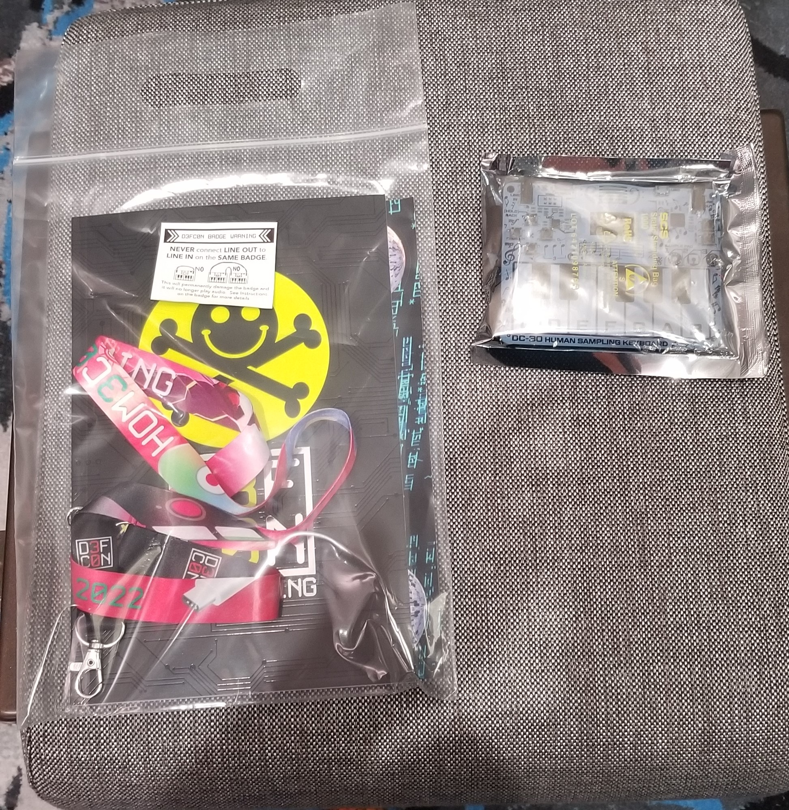
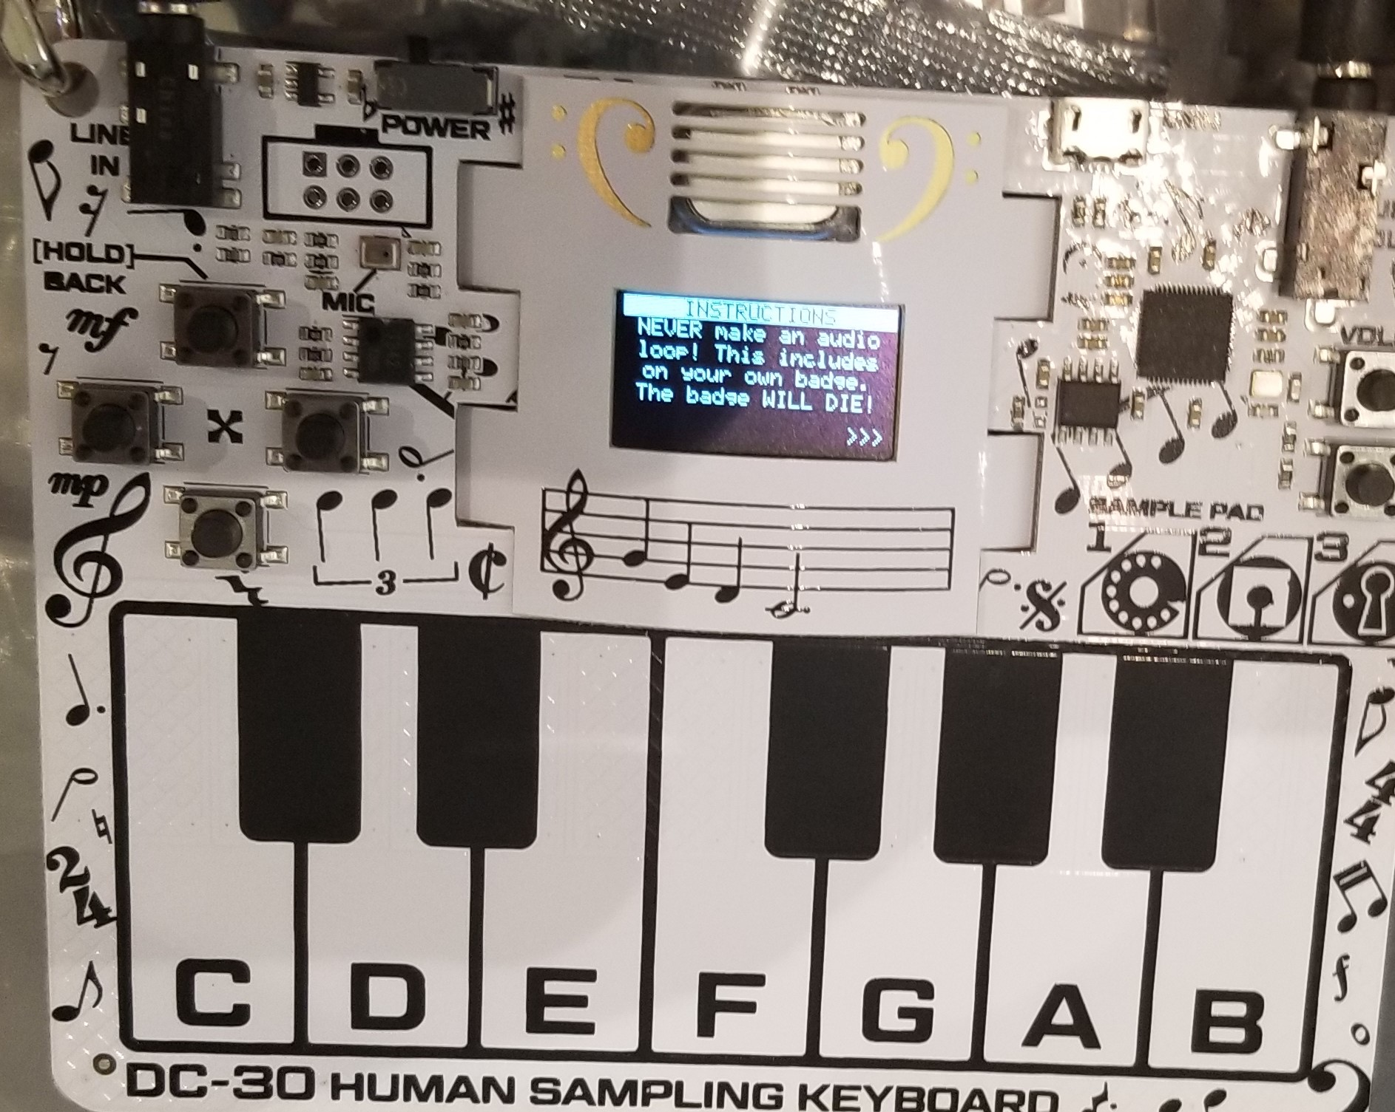
What is defcon?
Cybersecurity Conference
A place to have fun & learn

Slide 3
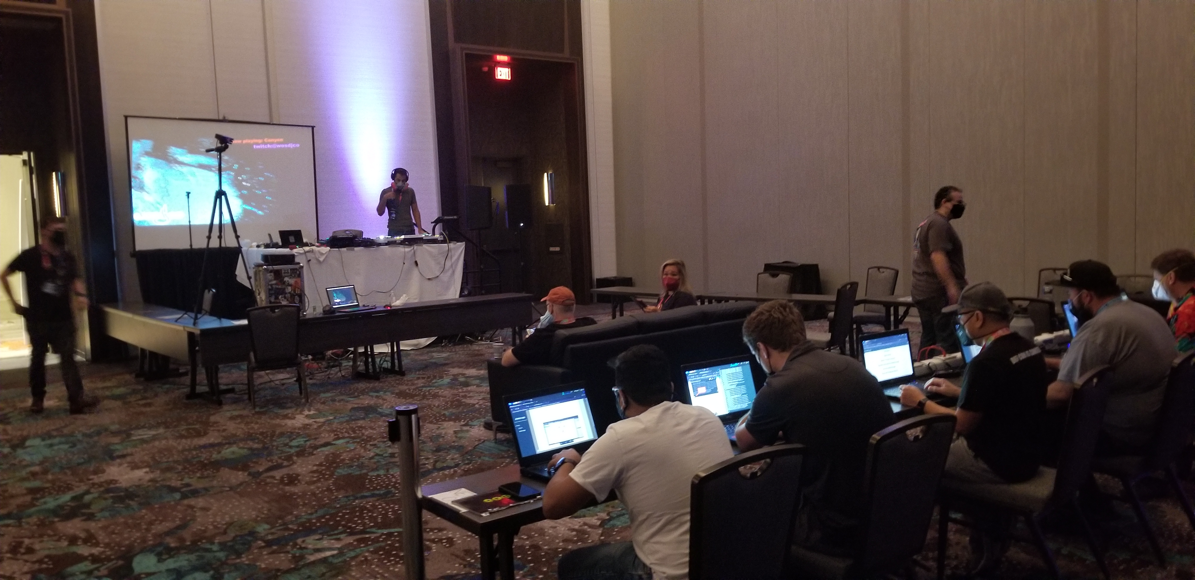
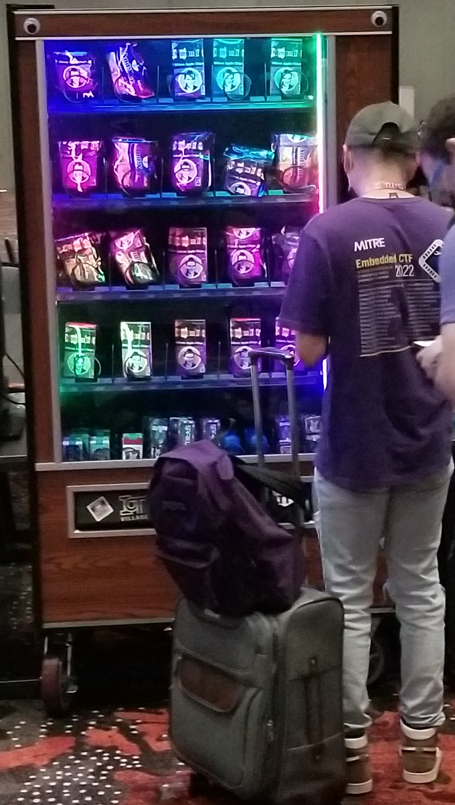
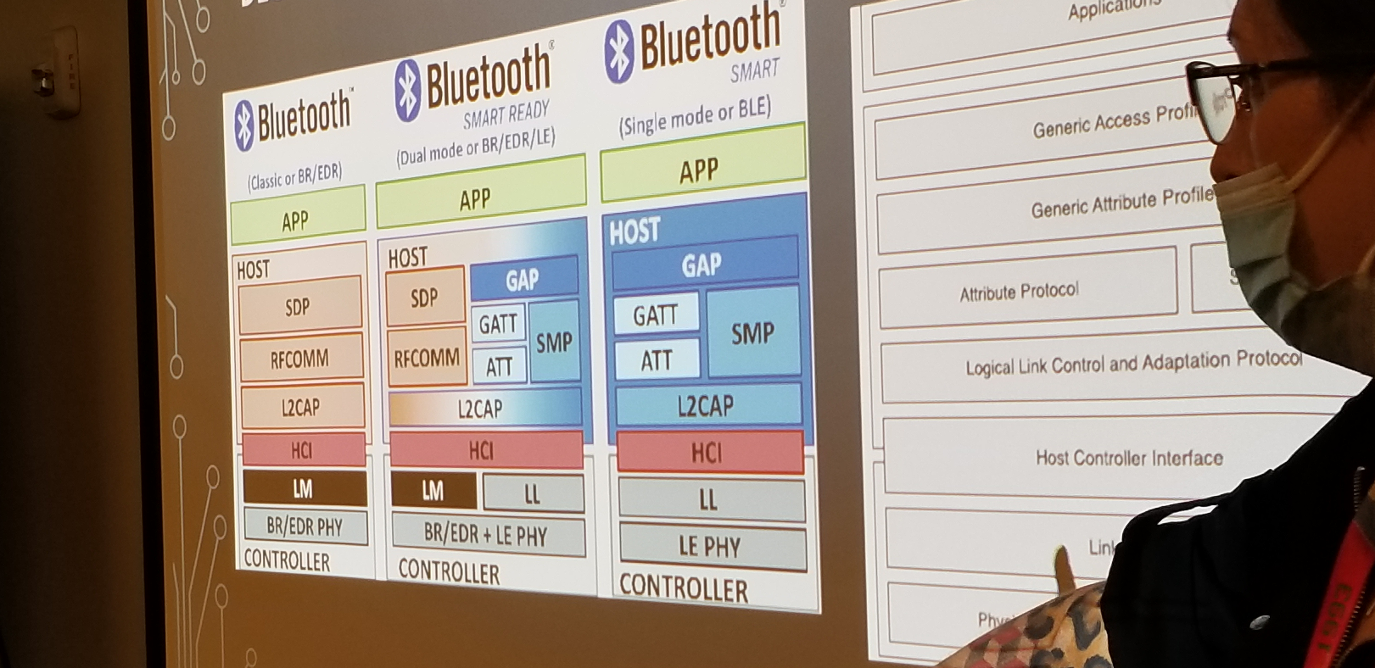
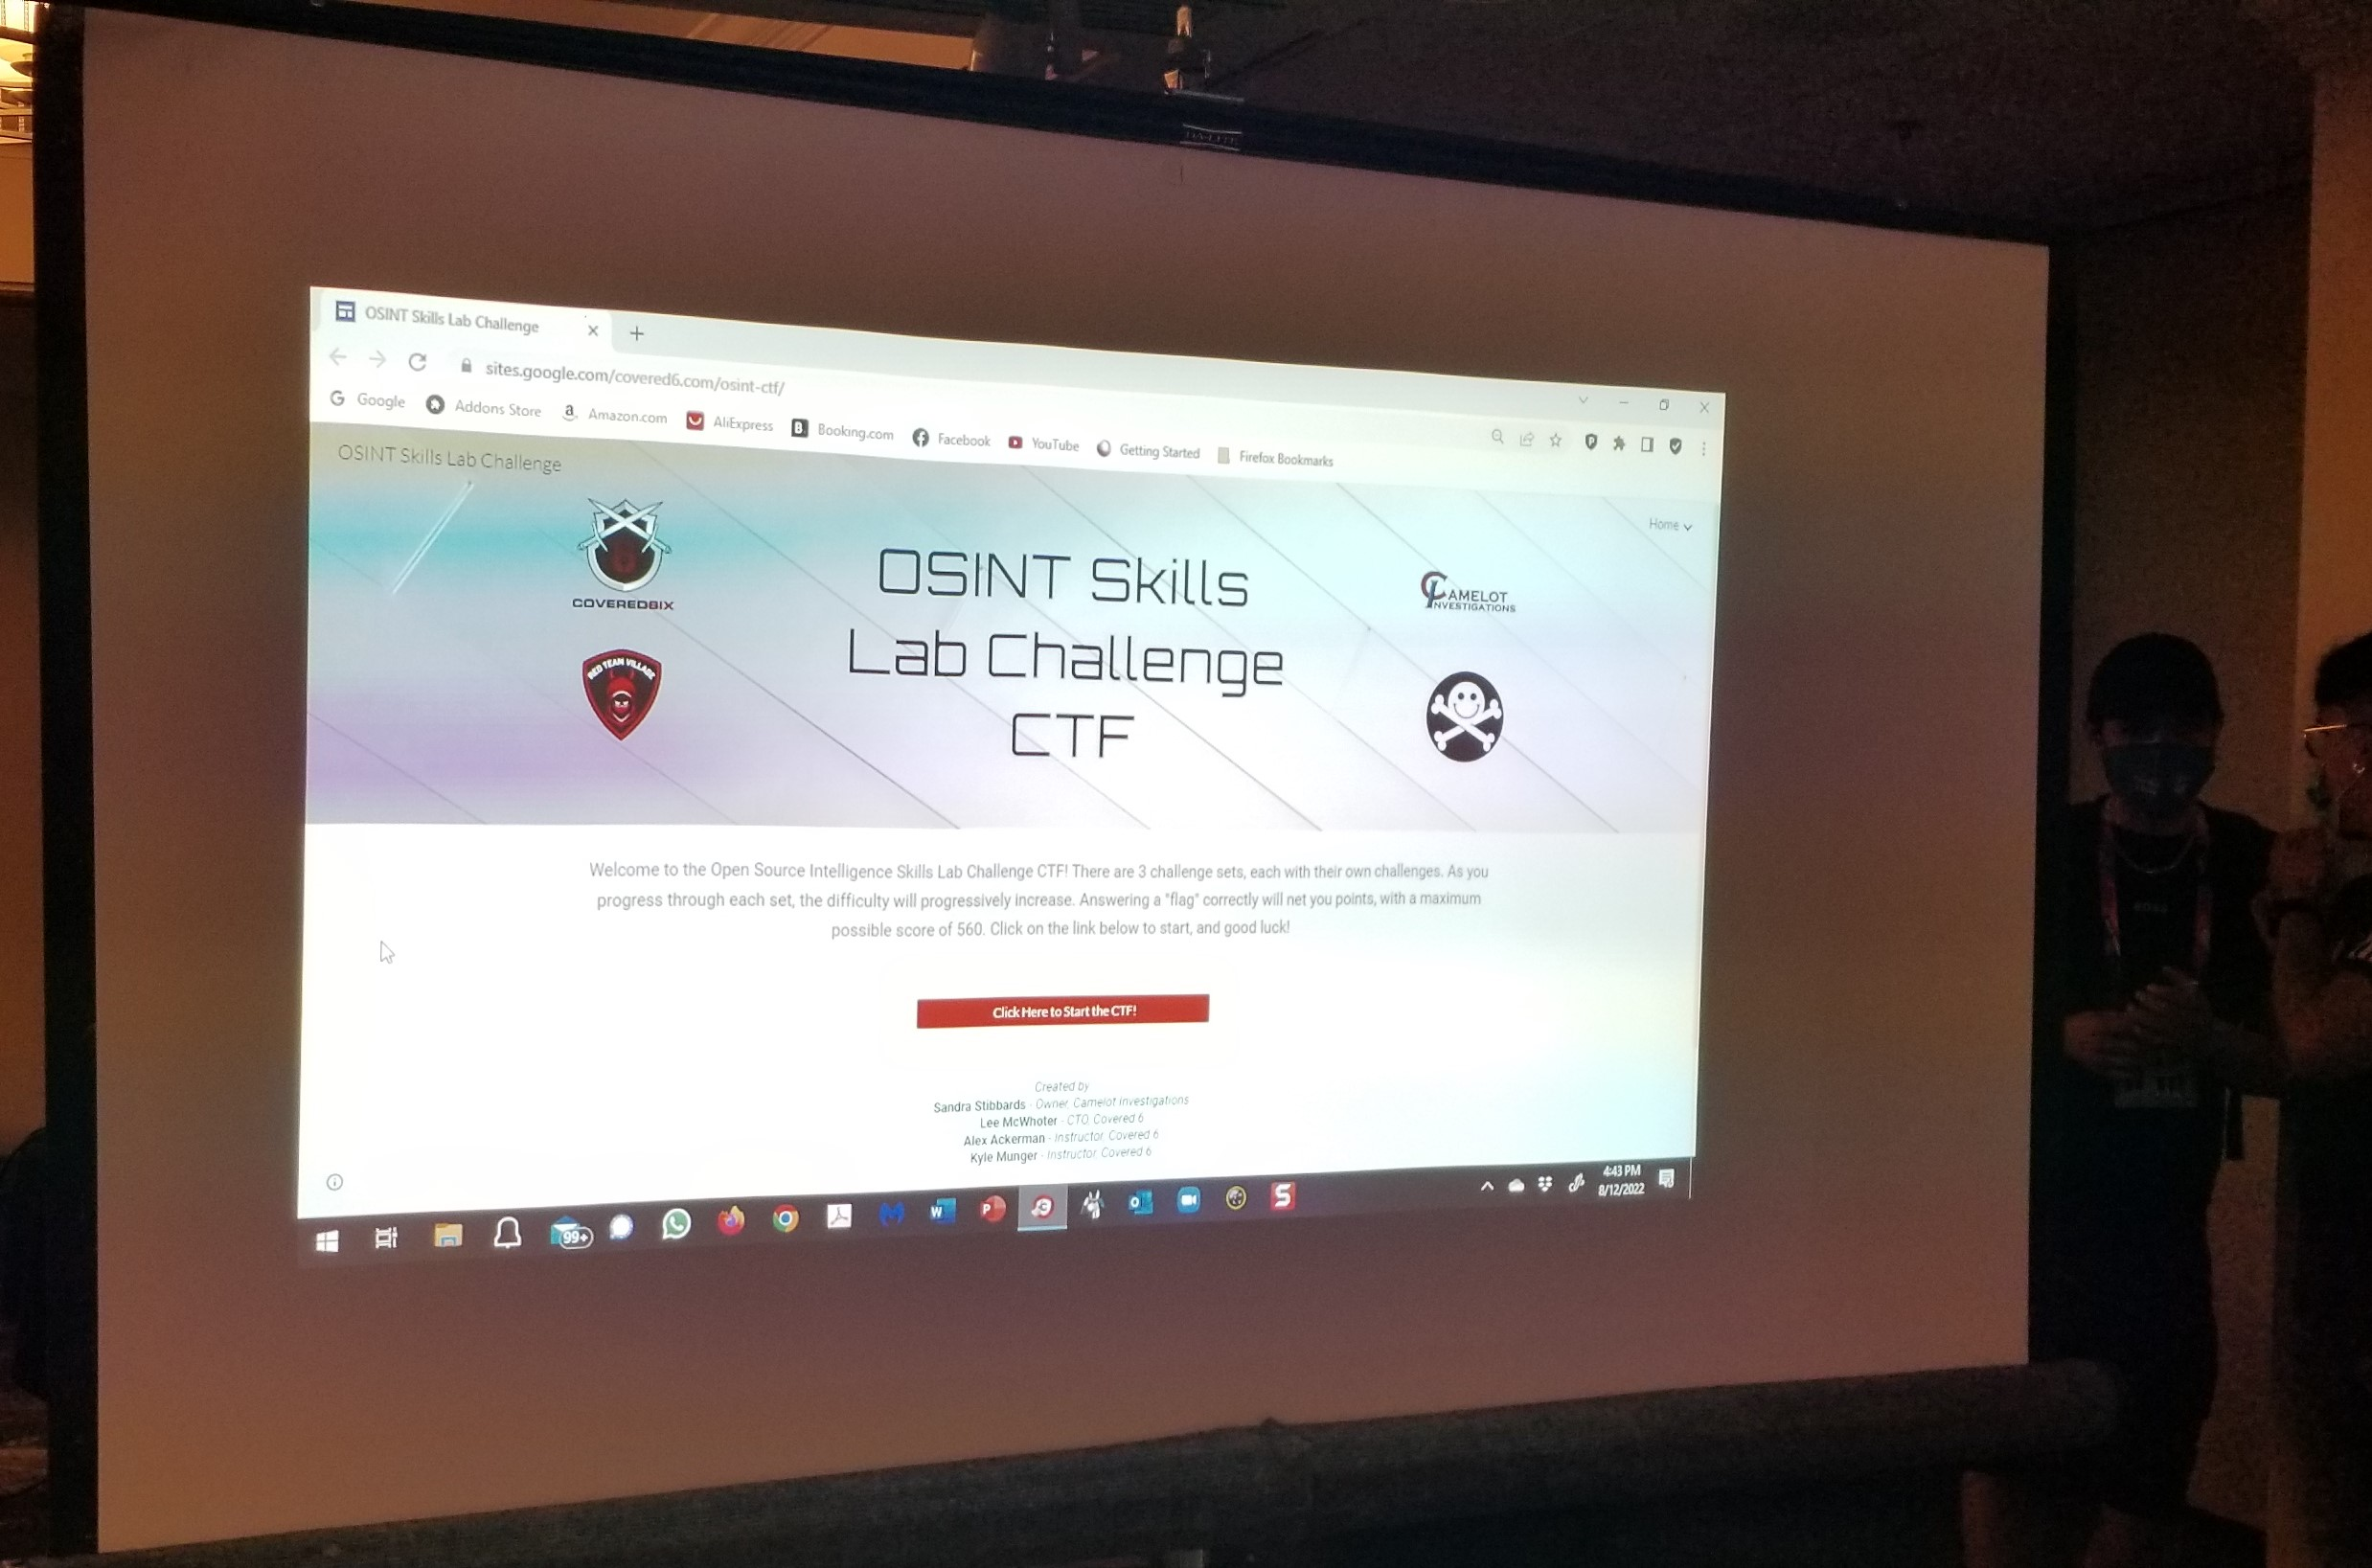
Things to do?
CTFs
Workshops
Make friends
Collect stickerS

Slide 4
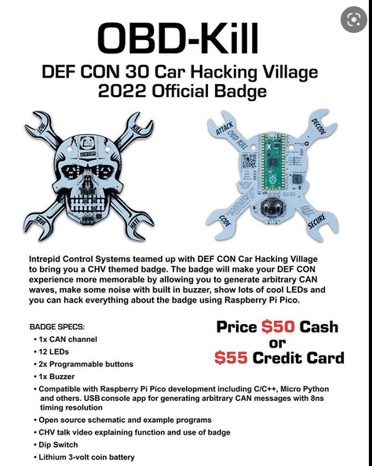

What are Villages?
A small group that focuses on a specific area of Security
Provides on hands-on labs
COMPETITIVE ctfs
Host talks on various topics

Slide 5

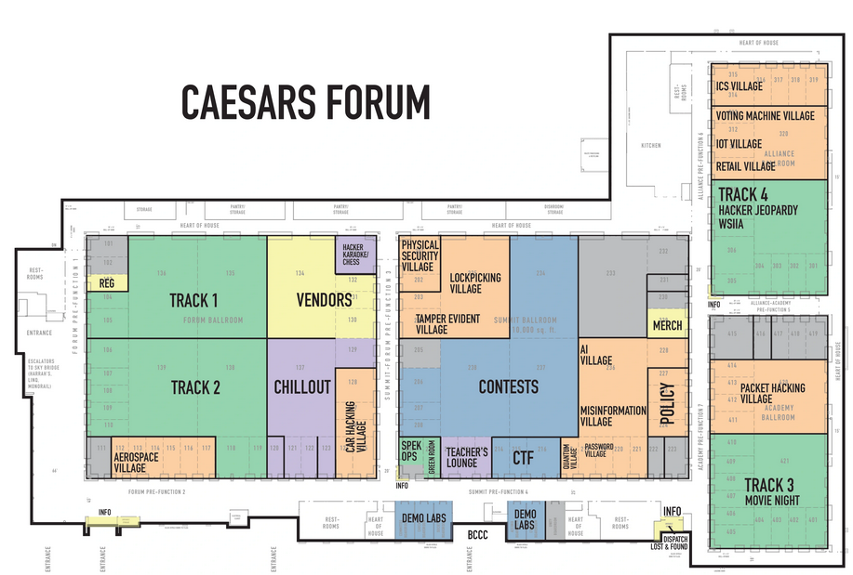
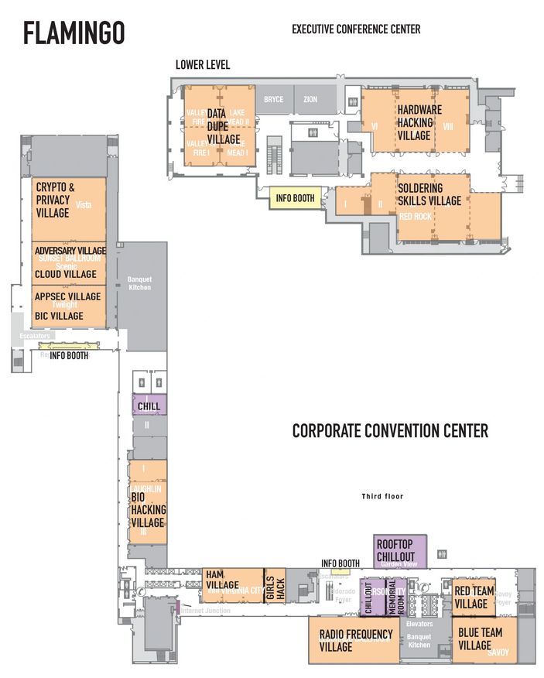
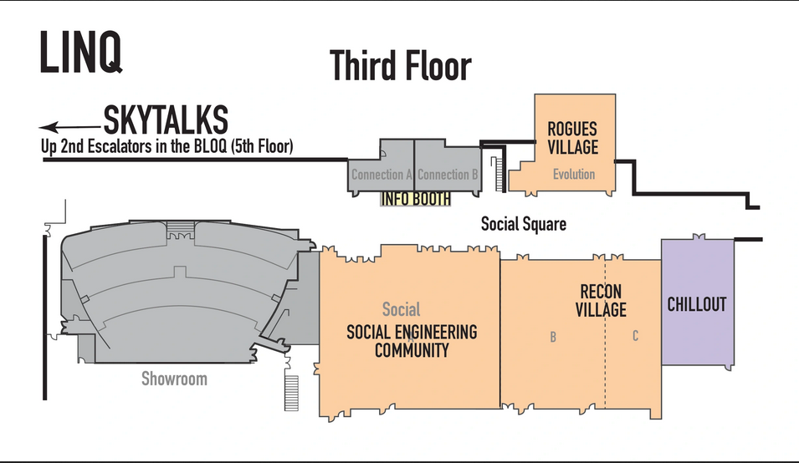
Floor Plans

Slide 6
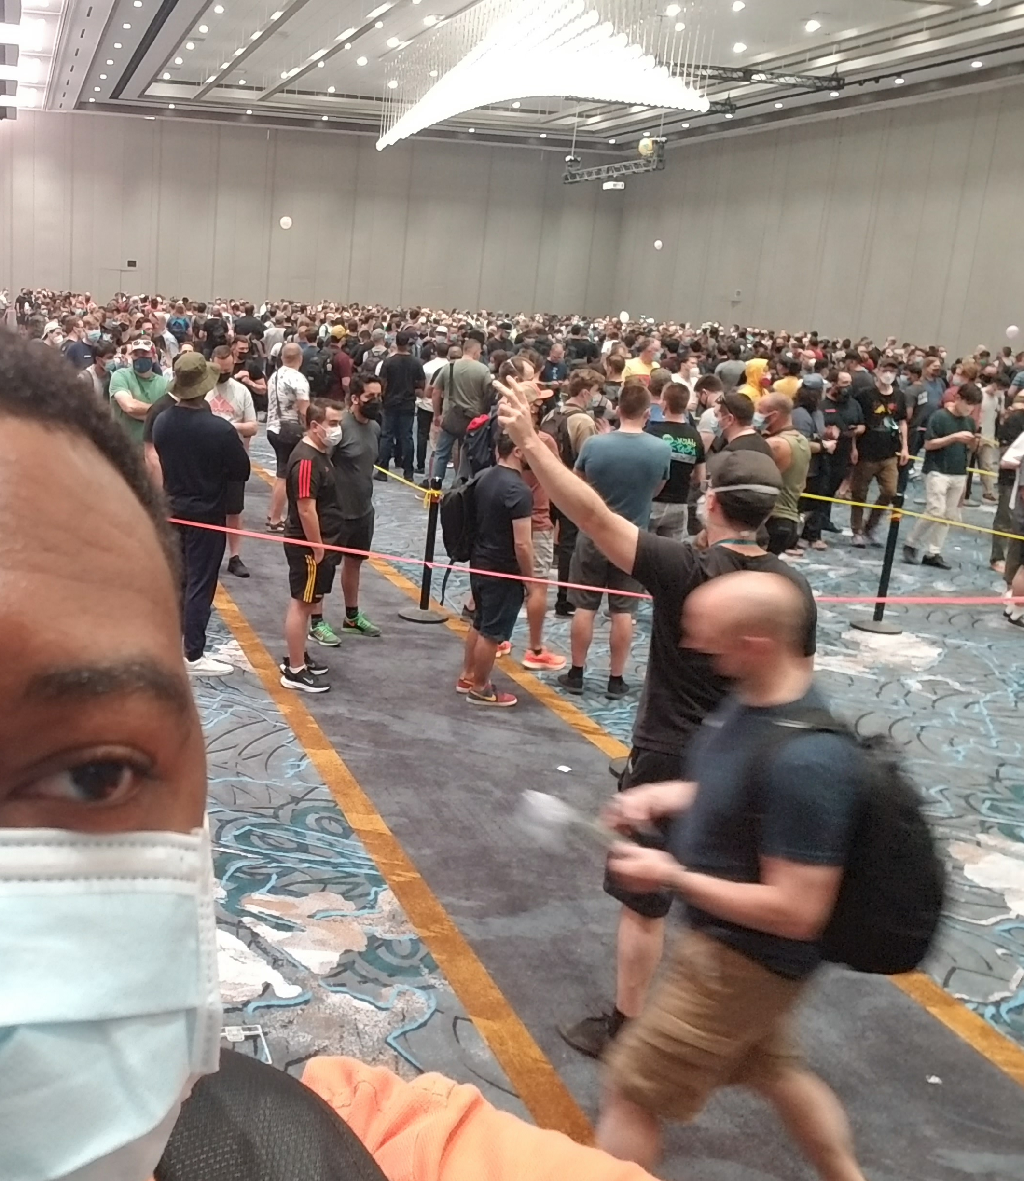
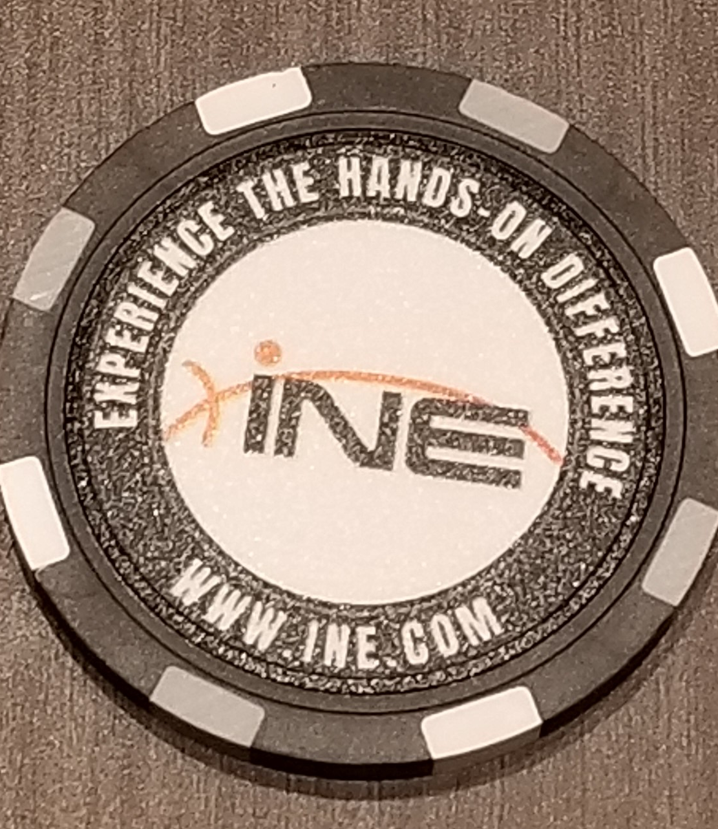

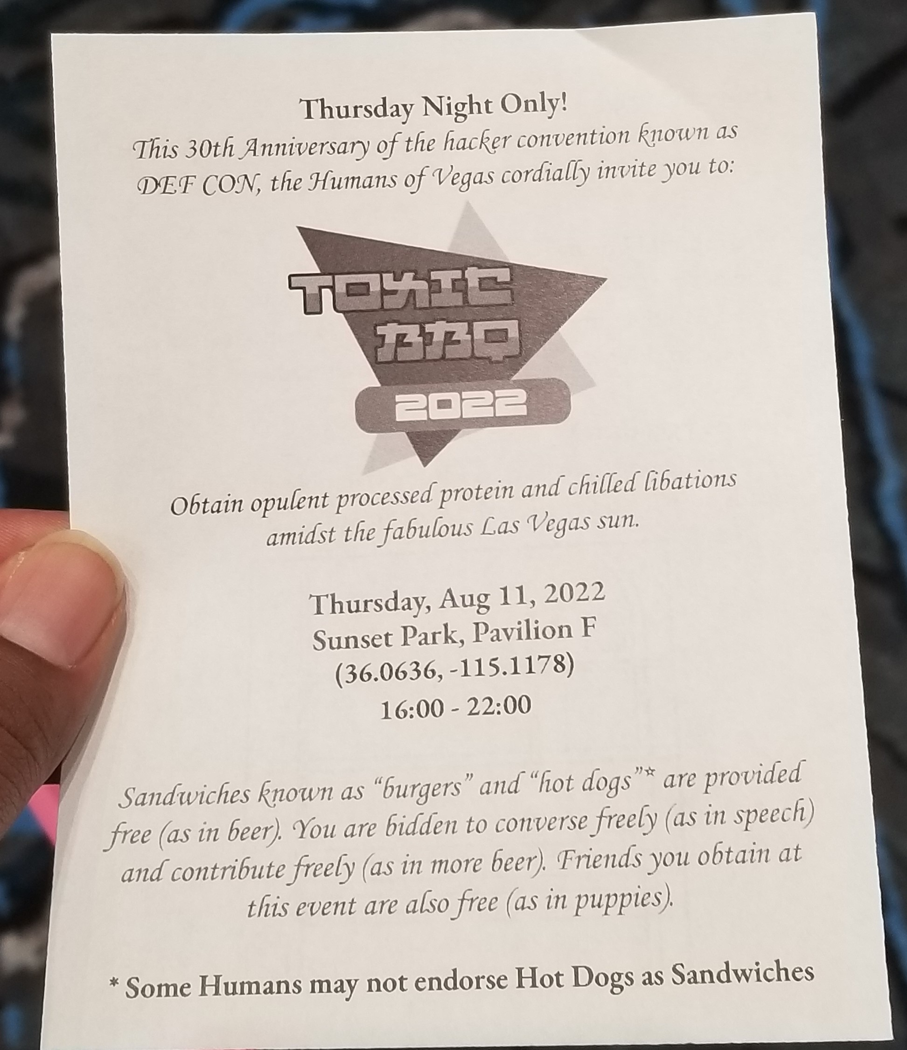
Pictures

Slide 7
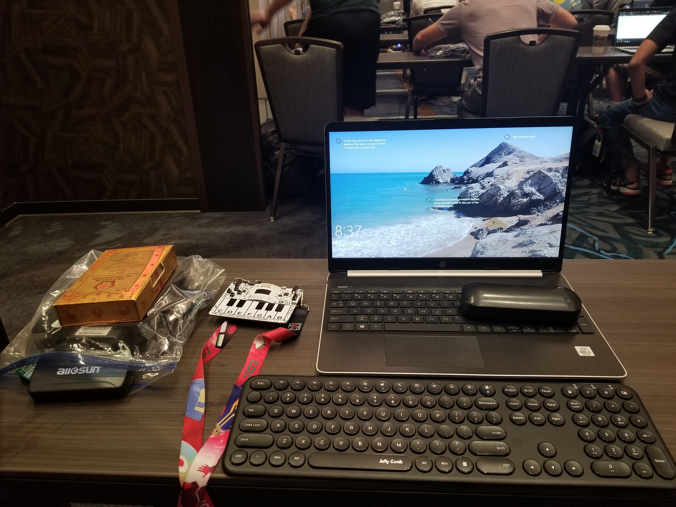
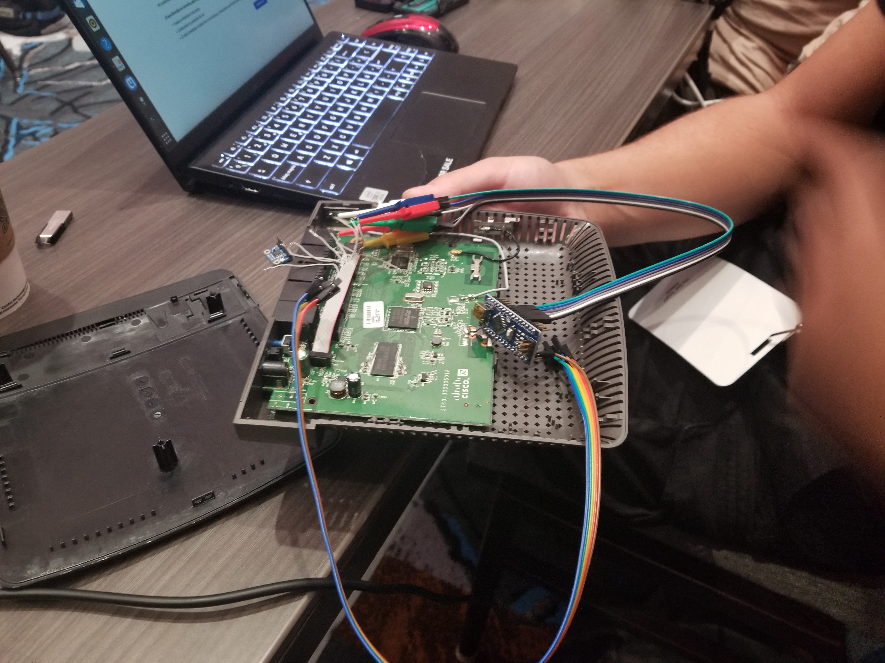
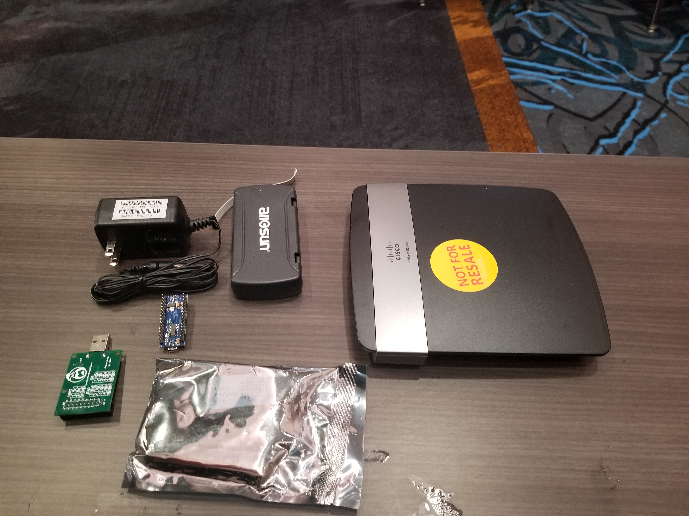
PostCon Workshop OFFENSIVE IOT EXPLOITATION

Slide 8
Benefits of going to a conference
Meet new people
Learn new things
Give you a sense of focus
Discounts on Merch
Free training
Level up

Slide 9
Questions???

